Slide 1


Slide 2


MIXTURES AND ALLIGATIONS

Slide 3
Question 01:
8 litres are drawn from a cask filled with wine and is then filled
with water. This operation is performed three more times. The ratio of the quantity of wine now left in cask to that of the total solution is 16:81.How much wine did the cask hold originally?
A. 24 litres
B. 45 litres
C. 49 litres
D. 44 litres
Answer: A

Slide 4
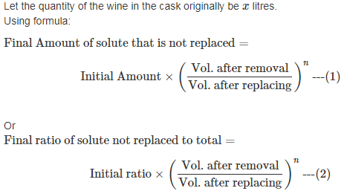
Explanation:

Slide 5
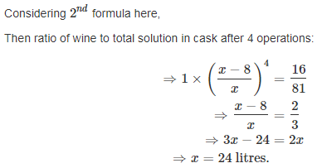
Explanation:

Slide 6
Question 02:
A man travelled a distance of 90Km in 9 hours partly on foot at 8 kmph and partly on bicycle at 17 kmph. Find the distance travelled on foot.
A. 46 km
B. 56 km
C. 62 km
D. 52 km
Answer: B

Slide 7
Explanation:
Distance covered in 1 hour on foot = 8 km Distance covered in 1 hour on bicycle = 17 km Average distance covered in 1 hour = 90/9 km = 10km (mean distance)
Distance covered in Distance covered in
1 hour on foot 1 hour on bicycle
(8 km) (17 km)
\ / Mean Distance
(10 km)
/ \
(17 – 10) : (10 – 8)
7 2
Thus out of 9 hours, he took 7 hours on foot Distance covered on foot =(8×7) Km =56 Km.

Slide 8
Question 03:
A vessel is filled with liquid, 3 parts of which are water and 5 parts syrup.
What part of the mixture must be drawn off and replaced with water so that the mixture may be half water and half syrup?
A. 7/11
B. 6/7
C. 1/5
D. 2/7
Answer: C

Slide 9
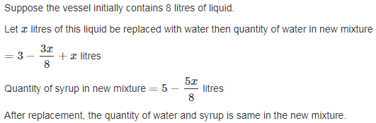
Explanation:

Slide 10
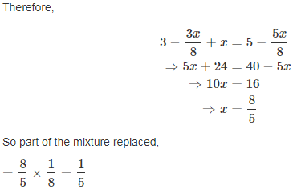
Explanation:

Slide 11
Question 04:
A milk vendor has 2 cans of milk .The first contains 25% water and the rest milk. The second contains 50% water. How much milk should he mix from each of the container so as to get 12 litres of milk such that the ratio of water to milk is 3:5?
A. 6 litres
B. 1 litres
C. 8 litres
D. 7 litres
Answer: A

Slide 12
Explanation:
Milk in 1 litre mixture in 1st can = 3/4 litre. Milk in 1 litre mixture in 2n d can = 1/2 litre. Milk in 1 litre final mixture = 5/8 litre. By rule of alligation we have required ratio 5 : 8
3/4 1/2
\ / (5/8)
/ \
1/8 : 1/8
Therefore ratio of two mixtures: =1/8:1/8= =1:1
So, quantity of mixture taken from each can, =1/2×12 =6 litres

Slide 13
Question 05:
Tea worth Rs. 126 per kg and Rs. 135 per kg are mixed with a
third variety in the ratio 1 : 1 : 2. If the mixture is worth Rs 153 per kg, the price of the third variety per kg will be?
A. Rs. 147.50
B. Rs. 785.50
C. Rs. 175.50
D. Rs. 258.50
Answer: C

Slide 14
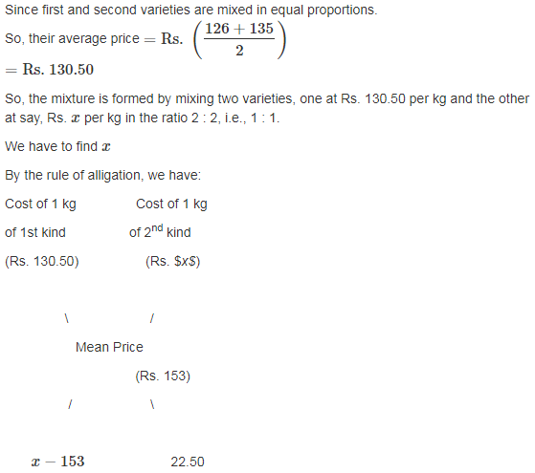

Explanation:

Slide 15
Question 06:
An alloy contains zinc, copper and tin in the ratio 2:3:1 and
another contains copper, tin and lead in the ratio 5:4:3. If equal weights of both alloys are melted together to form a third alloy, then the weight of lead per kg in new alloy will be:
A. 1/10 kg
B. 1/8 kg
C. 1/4 kg
D. 1/2 kg
Answer: B

Slide 16
Explanation:
In the first alloy, ratio of Zinc, Copper and Tin is given as,
Z:C:T=2:3:1
Similarly, In the second alloy, ratio of Copper, Tin and Lead is given as,
C:T:L=5:4:3
To do that, we take LCM of 6(=2+3+1), taken as 2 kg Zinc, 3 kg Copper and 1 Kg Lead), and 12(=5+4+3), taken as 5 kg Copper, 4 kg Tin and 3 Kg Lead, which is 12.
Thus we assume that both the alloys are being mixed at 12 Kgs each.
Alloys are mixed together to form third alloy. Then the ratio of content in it,
Z:C:T:L=4:(6+5):(2+4):3
Weight of the third alloy,
T=12+12=24 Kg.
So, weight of the Lead,
L=3/24
=1/ 8 kg

Slide 17
Question 07:
A 20 litre mixture of milk and water contains milk and water in the ratio
3 : 2. 10 litres of the mixture is removed and replaced with pure milk and the operation is repeated once more. At the end of the two removals and replacement, what is the ratio of milk and water in the resultant mixture?
A. 17 : 3
B. 9 : 1
C. 3 : 17
D. 5 : 3
Answer: B

Slide 18
Explanation:
The 20 litre mixture contains milk and water in the ratio of 3 : 2. Therefore, there
will be 12 litres of milk in the mixture and 8 litres of water in the mixture. Step 1. When 10 litres of the mixture is removed, 6 litres of milk is removed and 4 litres of water is removed. Therefore, there will be 6 litres of milk and 4 litres of water left in the container. It is then replaced with pure milk of 10 litres. Now the container will have 16 litres of milk and 4 litres of water. Step 2. When 10 litres of the new mixture is removed, 8 litres of milk and 2 litres of water is removed. The container will have 8 litres of milk and 2 litres of water in it. Now 10 litres of pure milk is added. Therefore, the container will have 18 litres of milk and 2 litres of water in it at the end of the second step. Therefore, the ratio of milk and water is
18 : 2 or 9 : 1.

Slide 19
Question 08:
How many kgs of Basmati rice costing Rs. 42/kg should a shopkeeper mix with 25 kgs of ordinary rice costing Rs. 24 per kg so that he makes a profit of 25% on selling the mixture at Rs. 40/kg?
A. 20.0 kgs
B. 12.5 kgs
C. 16.0 kgs
D. 200.0 kgs
Answer: A

Slide 20
Explanation:
Let the amount of Basmati rice being mixed be x kgs.
As the trader makes 25% profit by selling the mixture at Rs.40/kg, his cost per
kg of the mixture = Rs.32/kg.
i.e. (x×42)+(25×24)=32(x+25)
⇒ 42x+600=32x+800
⇒ 10x=200
⇒ x=20kgs.

Slide 21
Question 09:
In what ratio must a person mix three kinds of wheat costing him Rs. 1.20, Rs.1.44 and Rs. 1.74 per kg so that the mixture may be worth Rs. 1.41 per kg?
A. 11 : 77 : 7
B. 25 : 45 : 8
C. 27 : 23 : 6
D. 11 : 45 : 7
Answer: A

Slide 22
Explanation:
Quantity of 1st kind of wheat / Quantity of 2nd kind of wheat
=3/21=1/7.
So they must be mixed in the ratio 1 : 7.Thus,
(Quantity of 2nd kind of wheat / Quantity of 3rd kind of wheat)=
(Quantity of 1st kind of wheat / Quantity of 3rd kind of wheat)×(Quantity of 2nd
kind of wheat / Quantity of 1st kind of wheat)
⇒(Quantity of 2nd kind of wheat / Quantity of 3rd kind of wheat)
=(11/7×7/1)=(11/1)
Thus, Quantities of wheat of 1st:2nd:3rd=11:77:7

Slide 23
Question 10:
How many litres of water should be added to a 30 litre mixture of milk and water containing milk and water in the ratio of 7 : 3 such that the resultant mixture has 40% water in it?
A. 5 litres
B. 7 litres
C. 10 litres
D. None of these
Answer: A

Slide 24
Explanation:
30 litres of the mixture has milk and water in the ratio 7 : 3. i.e. the solution has
21 litres of milk and 9 litres of water.
When you add more water, the amount of milk in the mixture remains constant
at 21 litres. In the first case, before addition of further water, 21 litres of milk
accounts for 70% by volume. After water is added, the new mixture contains
60% milk and 40% water.
Therefore, the 21 litres of milk accounts for 60% by volume.
Hence, 100% volume =21/0.6=35 litres.
We started with 30 litres and ended up with 35 litres.
Therefore, 5 litres of water was added.

Slide 25
Question 11:
A sample of x litres from a container having a 60 litre mixture of milk and water containing milk and water in the ratio of 2 : 3 is replaced with pure milk so that the container will have milk and water in equal proportions. What is the value of x?
A. 6 litres
B. 10 litres
C. 30 litres
D. None of these
Answer: B

Slide 26
Explanation:
The mixture of 60 litres has in it 24 litres of milk and 36 litres of
water. (2 : 3 :: milk : water)
When you remove x litres from it, you will remove 0.4x litres of milk and 0.6x litres
of water from it.
Take choice (2). According to this choice, x=10
So, when one removes, 10 litres of the mixture, one is removing 4 litres of milk
and 6 litres of water.
Therefore, there will be 20 litres of milk and 30 litres of water in the container.
Now, when you add 10 litres of milk, you will have 30 litres of milk and 30 litres of
water - i.e. milk and water are in equal proportion.

Slide 27
Question 12:
From a cask of milk containing 30 litres, 6 litres are drawn out and the cask is filled up with water. If the same process is repeated a second, then a third time, what will be the number of litres of milk left in the cask?
A. 5.12 litres
B. 12 litres
C. 14.38 litres
D. 15.36 litres
Answer: D

Slide 28
Explanation:
It is given by (x−y/x)^n of the whole quantity, where xx is the
initial quantity of milk in the cask y is the quantity of milk withdrawn in each process
and n is the number of processes.
Hence from the above rule it can be say that,
Quantity of milk left after the 3rd operation =30×[(30−6)/30]^n
=15.36 litres.

Slide 29
Question 13:
A zookeeper counted the heads of the animals in a zoo and found it to be 80. When he counted the legs of the animals he found it to be 260. If the zoo had either pigeons or horses, how many horses were there in the zoo?
A. 30
B. 40
C. 50
D. 60
Answer: C

Slide 30
Explanation:
Let the number of horses=x Then the number of pigeons=80−x. Each pigeon has 2 legs and each horse has 4 legs. Therefore, total number of legs =4x+2(80−x)=260
⇒4x+160−2x=260 ⇒2x=100 ⇒x=50.

Slide 31
Question 14 :
How many litres of a 12 litre mixture containing milk and water in the ratio of 2:3 be replaced with pure milk so that the resultant mixture contains milk and water in equal proportion?
A. 1.0 litres
B. 1.5 litres
C. 2.0 litres
D. 4.0 litres
Answer: C

Slide 32
Explanation:
The mixture contains 40% milk and 60% water in it. That is 4.8 litres of milk and
7.2 litres of water.
Now we are replacing the mixture with pure milk so that the amount of milk and
water in the mixture is 50% and 50%.That is we will end up with 6 litres of milk and
6 litres of water.
Water gets reduced by 1.2 litres.
To remove 1.2 litres of water from the original mixture containing 60% water, we
need to remove 1.2/0.6 litres of the mixture = 2 litres.

Slide 33
Question 15:
A merchant mixes three varieties of rice costing Rs. 20/kg, Rs. 24/kg and Rs. 30/kg and sells the mixture at a profit of 20% at Rs. 30/kg. How many kgs of the second variety will be in the mixture if 2 kgs of the third variety is there in the mixture?
A. 1 kg
B. 3 kgs
C. 5 kgs
D. 6 kgs
Answer: C

Slide 34
Explanation:
If the selling price of the mixture is Rs.30/kg and the merchant makes a profit of
20%, then the cost price of the mixture =30/1.2= Rs.25/kg.
We need to find out the ratio in which the three varieties are mixed to obtain a
mixture costing Rs.25 /kg.
Let variety A cost Rs.20/kg, variety B cost Rs.24 / kg and variety C cost
Rs.30/kg.
The mean desired price falls between B and C
Step 1:
Find out the ratio Qa:Qc using alligation rule.
Qa/Qc=(30−25/25−20)=1/1

Slide 35
Explanation:
Step 2:
Find out the ratio Qb:Qc using alligation rule.
Qb/Qc=(30−25/25−24)=5/1
Step 3:
Qc is found by adding the value of Qc in step 1 and step 2 =1+1=2

